Slide 1
Budget Calculator
14/F-D
Pálfi Gyula, Kincses Tamás, Halász Péter

Slide 2
The idea
The problem
Hard to remember the money flow
Complicated stock and currency pages
Information overflow
Solution
Budget Calculator
Easily manageable and see through
Clean

Slide 3
Functions
Registration
Login
Expenses and incomes creation and management
Currency Exchange

Slide 4






Used Technologies
Database – MySQL
DbForge
phpMyAdmin
Backend – Node.js
Postman
Express
Frontend – Vue.js
Bootstrap 5.0
Pinia

Slide 5
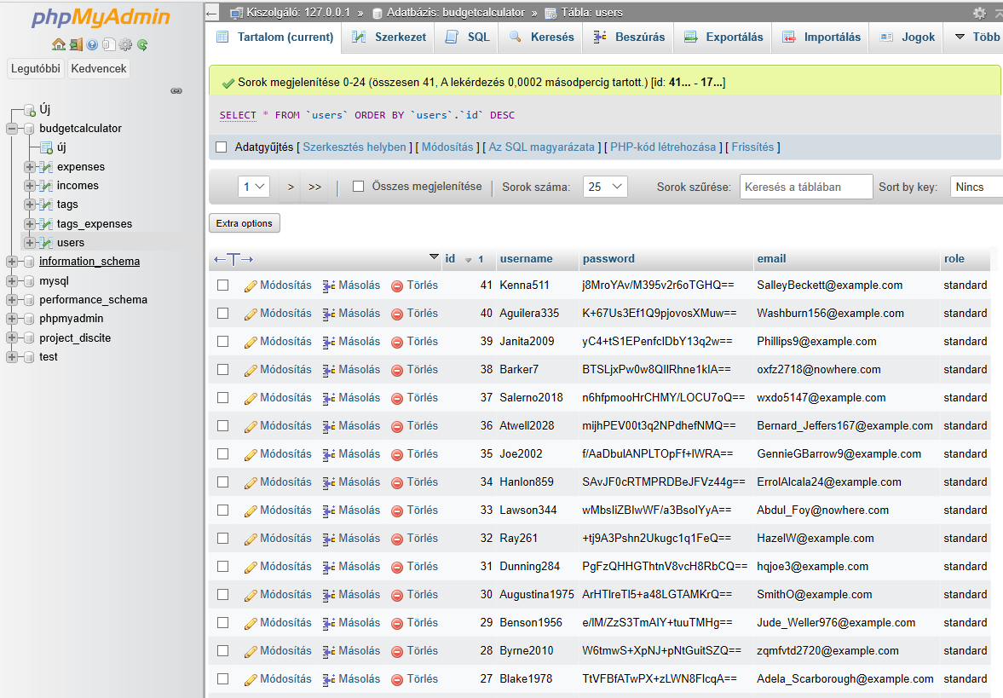

Database
MySQL
5 Table
DbForge Studio
PhpMyAdmin

Slide 6
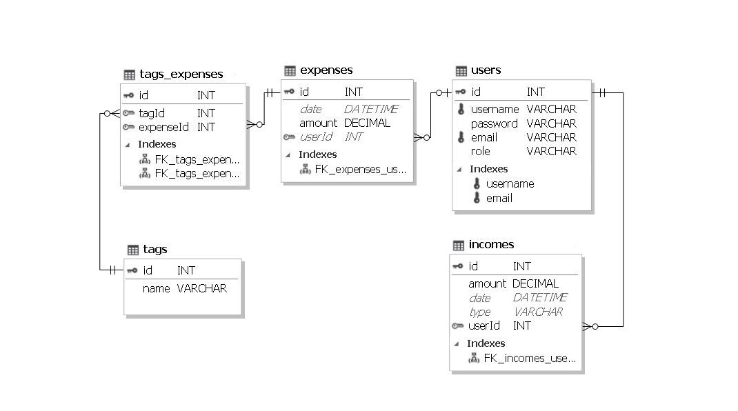

Slide 7
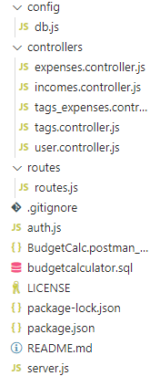

Backend
Node.Js
Express
Express-session
Bcrypt
Cookie-Parser

Slide 8
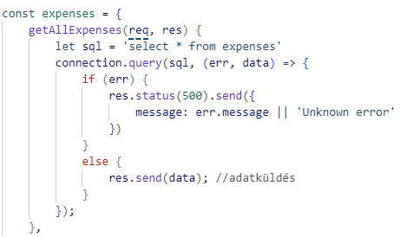
Controllers
Expenses
Incomes
Users
Tags
Tags_Expenses

Slide 9
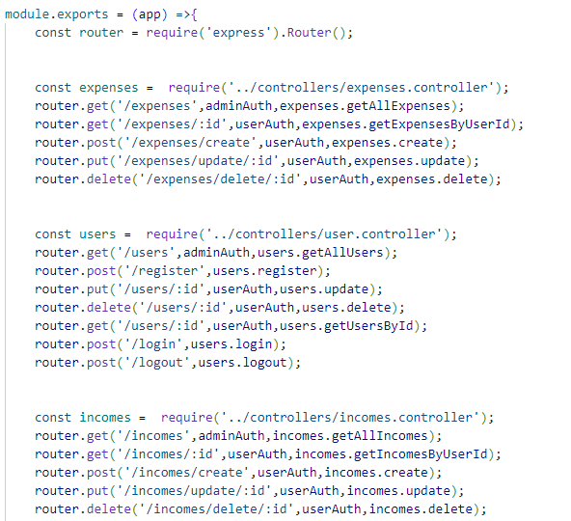
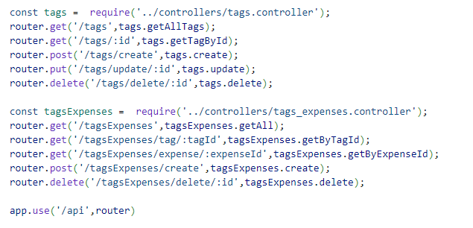
Routes

Slide 10
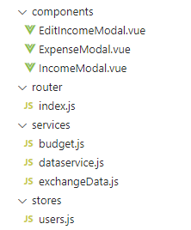
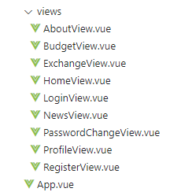
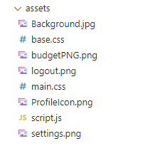

Frontend
Vue.js
Npm, piniastore
Bootstrap

Slide 11
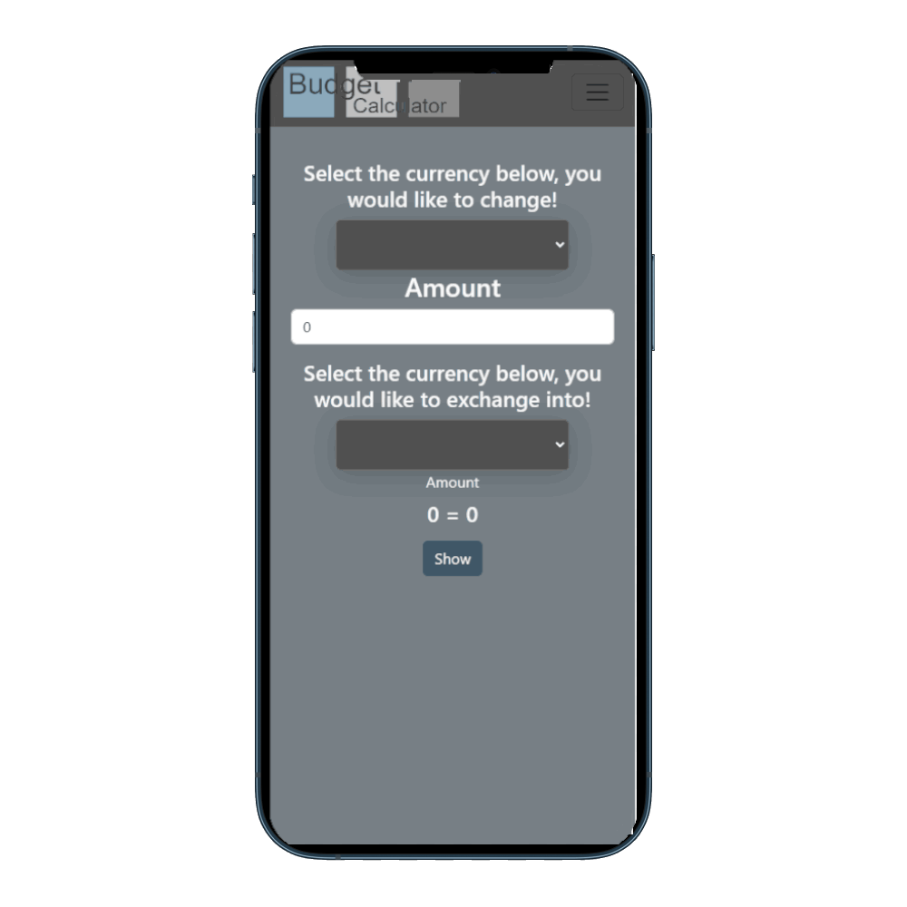
Responsivity
Optimized for mobile devices as well
Accessible from anywhere

Slide 12
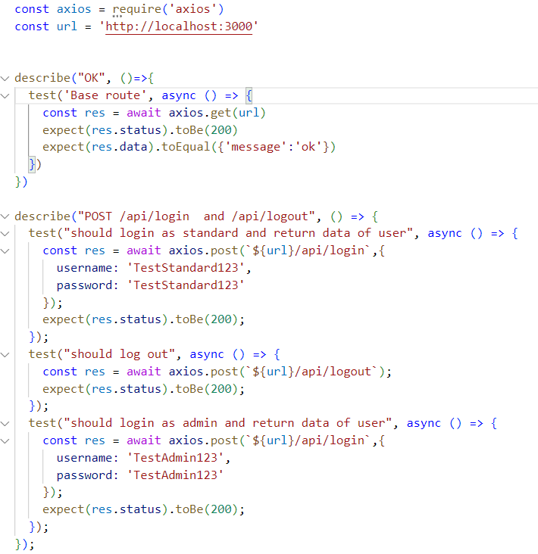

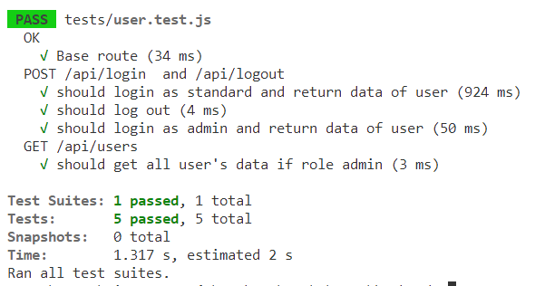
Tests
Unit test
Jest

Slide 13


Teamwork
GitHub
Discord
Fullstack
CleanCode

Slide 14
Backend slices
Halász Péter:
User controller
Incomes controller
Expenses controller
Tags controller
TagsExpenses controller
Database
Auth.js
Kincses Tamás:
User controller
Incomes controller
Expenses controller
Pálfi Gyula:
Incomes controller
Expenses controller

Slide 15
Frontend slices
Halász Péter:
News page
Kincses Tamás:
Login page
Register page
Budget page
Exchange page
Responsivity
User page
Pálfi Gyula:
Budget page
Exchange page
Responsivity
About us page
Dokuments

Slide 16

Future
Mobile app
Automated data input
Monetization

Slide 17
Budget Calculator demo

